Slide 1
Cleared for Takeoff: Predicting U.S. Flight Delays
May 4, 2026
Qixiang Fan, Qingyue Wang, Yiyu Chen, Zhuyun Jin, Omari Motta

Slide 2

Dataset
Data Source
BTS Airline On-Time Performance Database
Data Coverage
January-March 2025
3 monthly files
Scale
1823522 rows
23 columns

Slide 3

Data Cleaning
Fixed data types
Check duplicates
Missing values
Filled delay column
on-time flights: NaN -> 0
Flag extreme delays
791 flights with dealy > 1000 min kept but marked IS_EXTREME_DEALY = 1

Slide 4
Exploratory Data Analysis Overview
We explored the cleaned dataset to understand the main structure and delay patterns.
The dataset contains over 1.8 million flight records from January to March 2025. The main outcome is ARR_DEL15, which indicates whether a flight arrived at least 15 minutes late.
Our EDA focuses on target imbalance, time-based patterns, airport differences, and hidden operational profiles from unsupervised learning.
Number of rows: 1,823,522
Number of columns: 16
Number of carriers: 21
Number of origin airports: 353
Number of destination airports: 353
Arrival delay rate: 19.7%

Slide 5
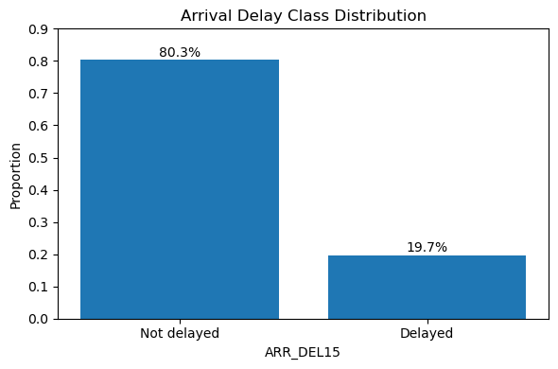
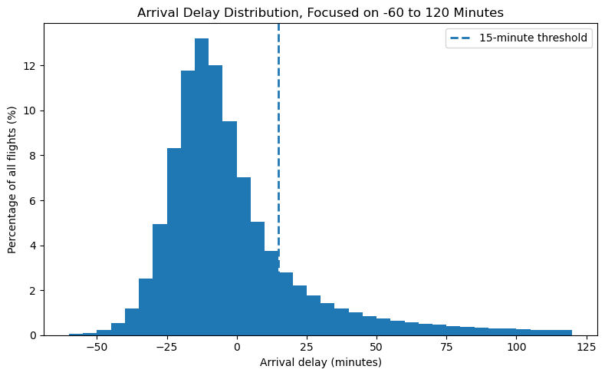
Delay Outcome Overview
We first analyzed the delay outcome from both a classification and continuous-delay perspective.
The target variable ARR_DEL15 is imbalanced: around 80.3% of flights were not delayed by 15 minutes or more, while only 19.7% were delayed. This means accuracy alone may not be enough for model evaluation.
The arrival delay distribution also shows a clear right-skewed pattern. Most flights arrived early or close to schedule, but a smaller number of flights had long positive delays.

Slide 6
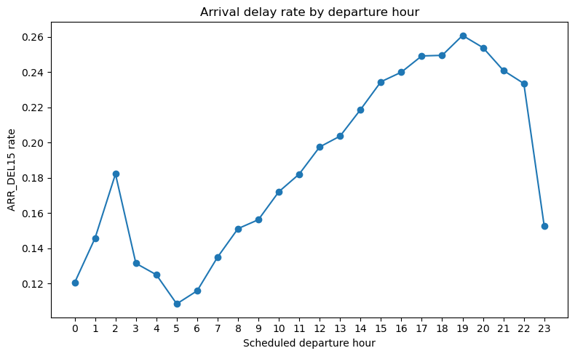
Delay by Departure Hour
Scheduled departure hour shows one of the clearest time-based delay patterns.
Early morning flights generally have lower arrival delay rates. Delay risk increases from late morning through the evening and reaches its highest level around 19:00.
This pattern reflect delay can build up throughout the day, such as aircraft rotation, crew scheduling, gate availability, and airport congestion.

Slide 7
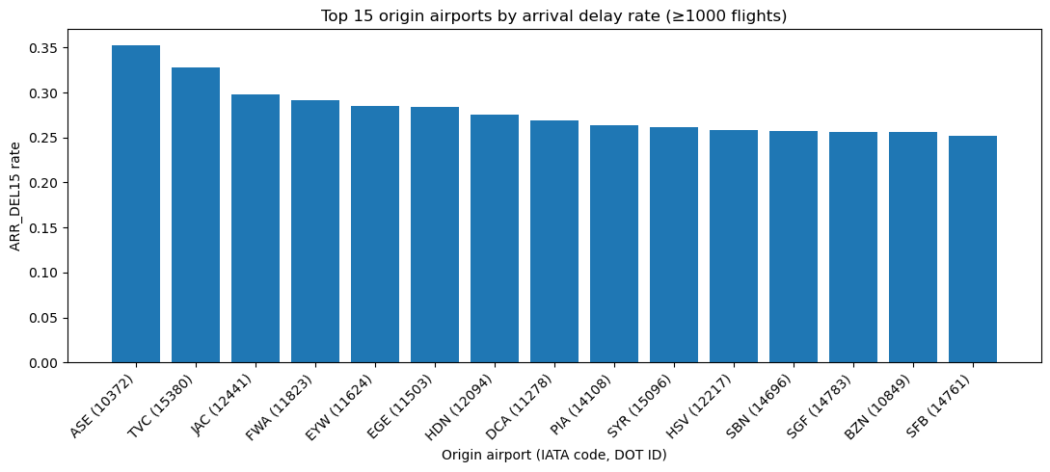
Delay Risk Varies Across Origin Airports
Arrival delay rates also vary across origin airports.
To avoid unstable rates from very small airports, we focused on airports with at least 1,000 flights. The top airports have delay rates much higher than the overall average of 19.7%.
This suggests that airport-level factors, such as congestion, local weather exposure, traffic volume, and operational constraints, may affect delay risk.

Slide 8
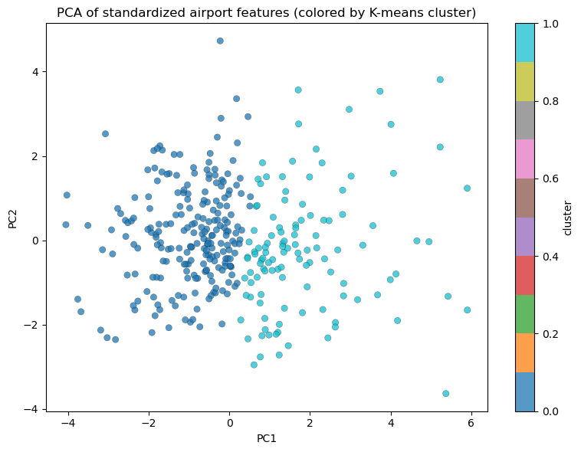
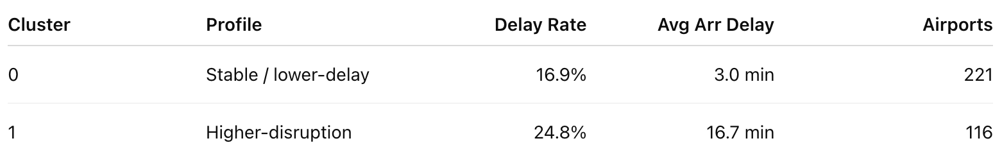
PCA and K-Means Reveal Airport Delay Profiles
Clustered origin airports based on delay-related patterns
Selected k = 2 because it had the highest silhouette score
Cluster 0: stable / lower-delay airports
Cluster 1: higher-disruption airports with higher delay rates
PCA was used to visualize the two airport profiles

Slide 9
Feature Engineering Strategy
Feature Creation
Created route-level and calendar-based features to capture operational patterns.
Key Features:
ROUTE = origin + destination
DAY_OF_WEEK and IS_WEEKEND
Cyclic departure/ Arrival time features
DISTANCE_BUCKET for haul categories
Model Readiness
Prepared a cleaner and more predictive feature set for downstream modeling.
Key Actions:
Removed leakage columns
Preserved useful numerical signals
Encoded categorical variables
Reduced redundant information

Slide 10
Final Preprocessing Pipeline
Split Data
80/20 train-test split
Stratified by ARR_DEL15
2. Transform Features
Median imputation for numeric variables
Most-frequent imputation for categorical variables
3. Encode & Scale
Standardized numeric features
One-hot encoded categorical features
4. Reduce & Export
Removed high-correlation features
Exported train/test-ready datasets
Final Output: 1,427,517 training rows | 356,880 testing rows | 6,214 processed features

Slide 11
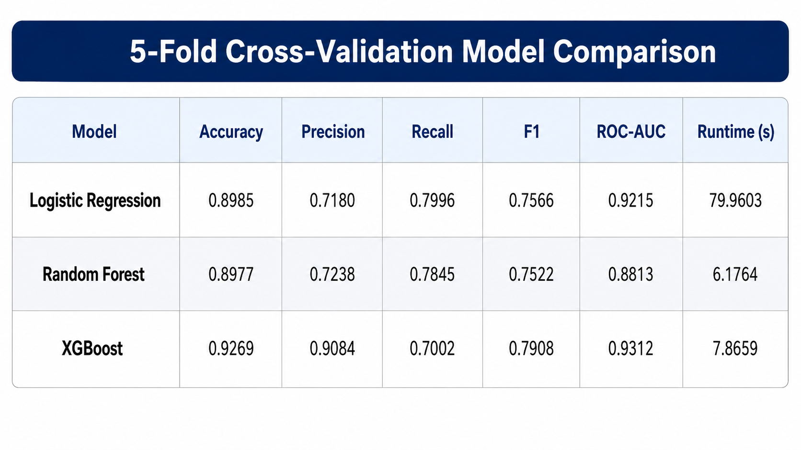
Model Comparison and Selection
We first compared three candidate classification models: Logistic Regression, Random Forest, and XGBoost.
To make the comparison fair, we used 5-fold cross-validation on the training sample and evaluated each model using accuracy, precision, recall, F1 score, ROC-AUC, and runtime.
5-fold cross-validation shows that XGBoost provides the best overall balance between predictive accuracy and classification quality.
Among the three models, XGBoost achieved the strongest overall performance, especially in CV F1 and ROC-AUC, so we selected it for further tuning and final evaluation.

Slide 12
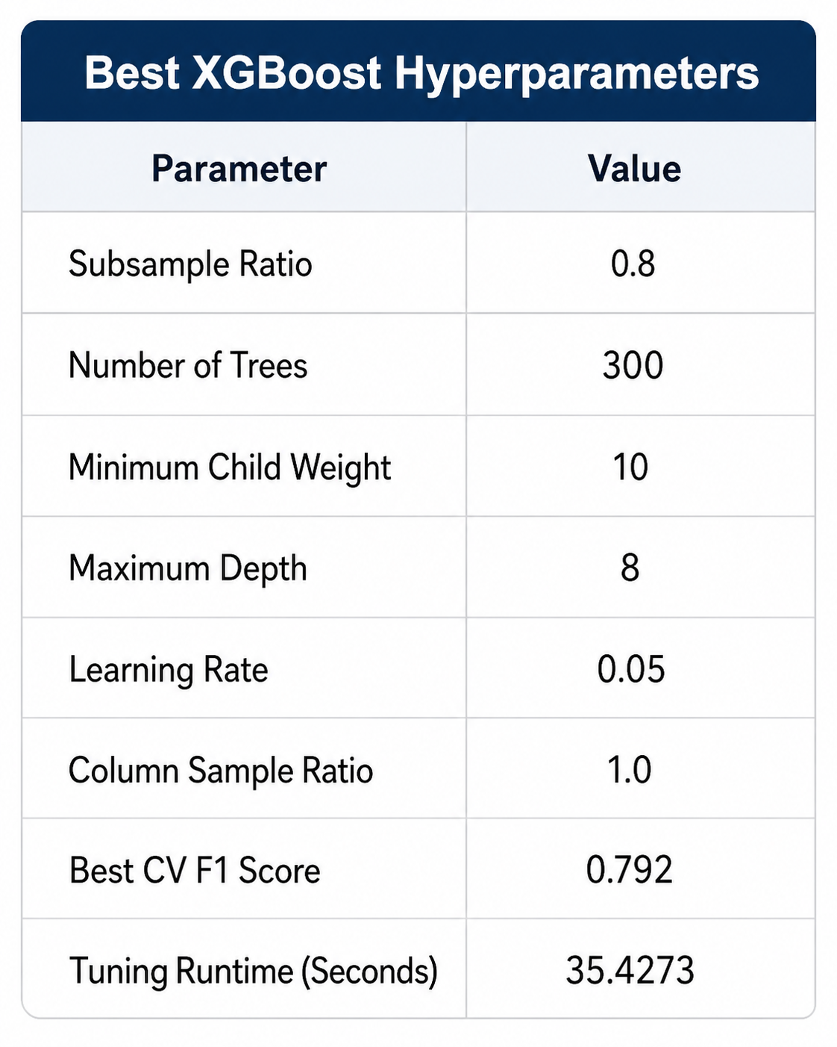
XGBoost Hyperparameter Tuning
After selecting XGBoost as the main model, we performed hyperparameter tuning to improve its performance.
The tuning process tested different combinations of tree depth, learning rate, number of estimators, subsampling rate, column sampling rate, and child-weight constraints.
The final selected parameters were chosen based on cross-validation F1 score, because F1 balances precision and recall and is more informative than accuracy alone for delay prediction.
The best XGBoost setting was selected using cross-validation, with F1 score as the main optimization metric.

Slide 13
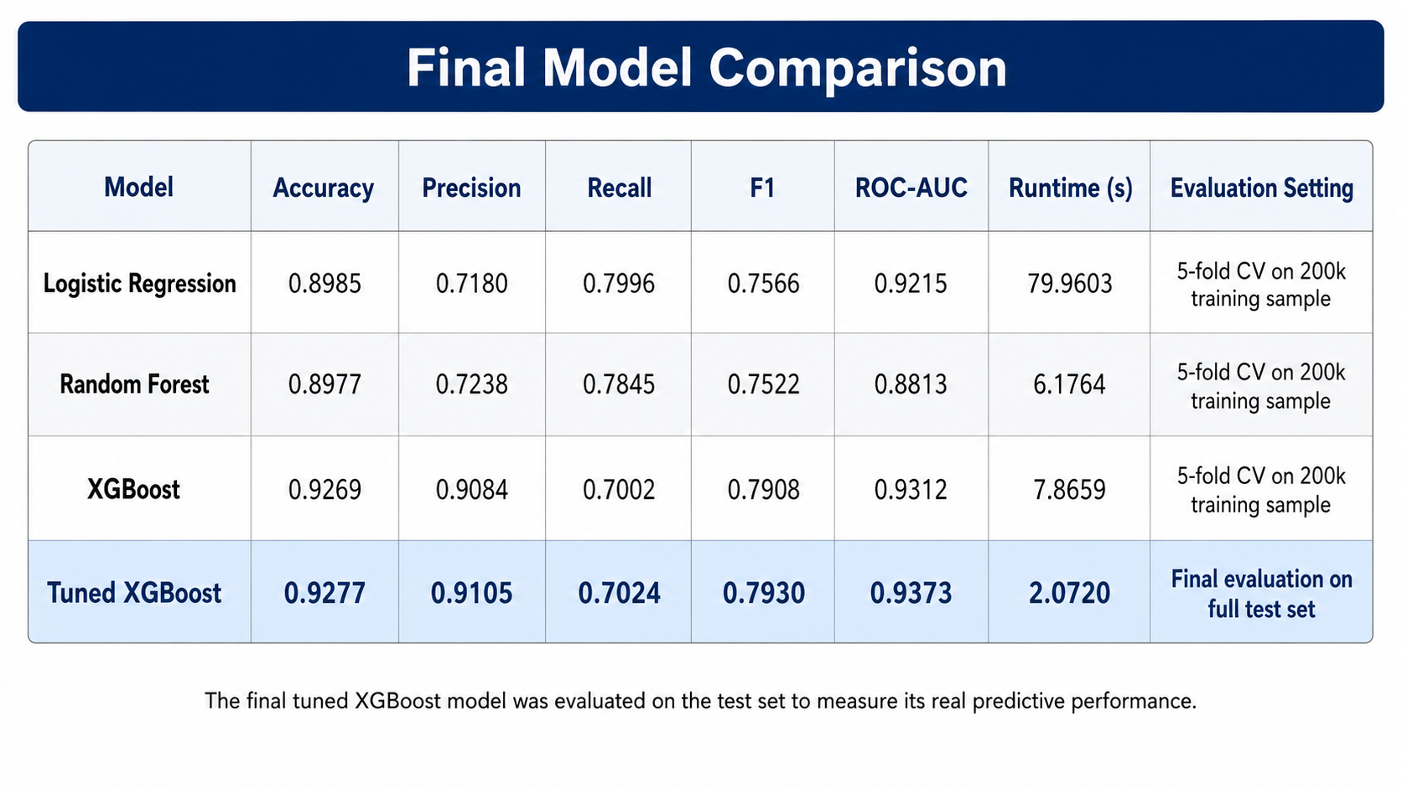
Final Model Performance
The final model maintained strong test performance, showing that the tuning result generalized beyond the cross-validation sample.
Compared with the baseline models, the tuned XGBoost model provided the most reliable overall performance and became our final prediction model.
Using the selected hyperparameters, we trained the final XGBoost model on the full training set and evaluated it on the held-out test set.

Slide 14
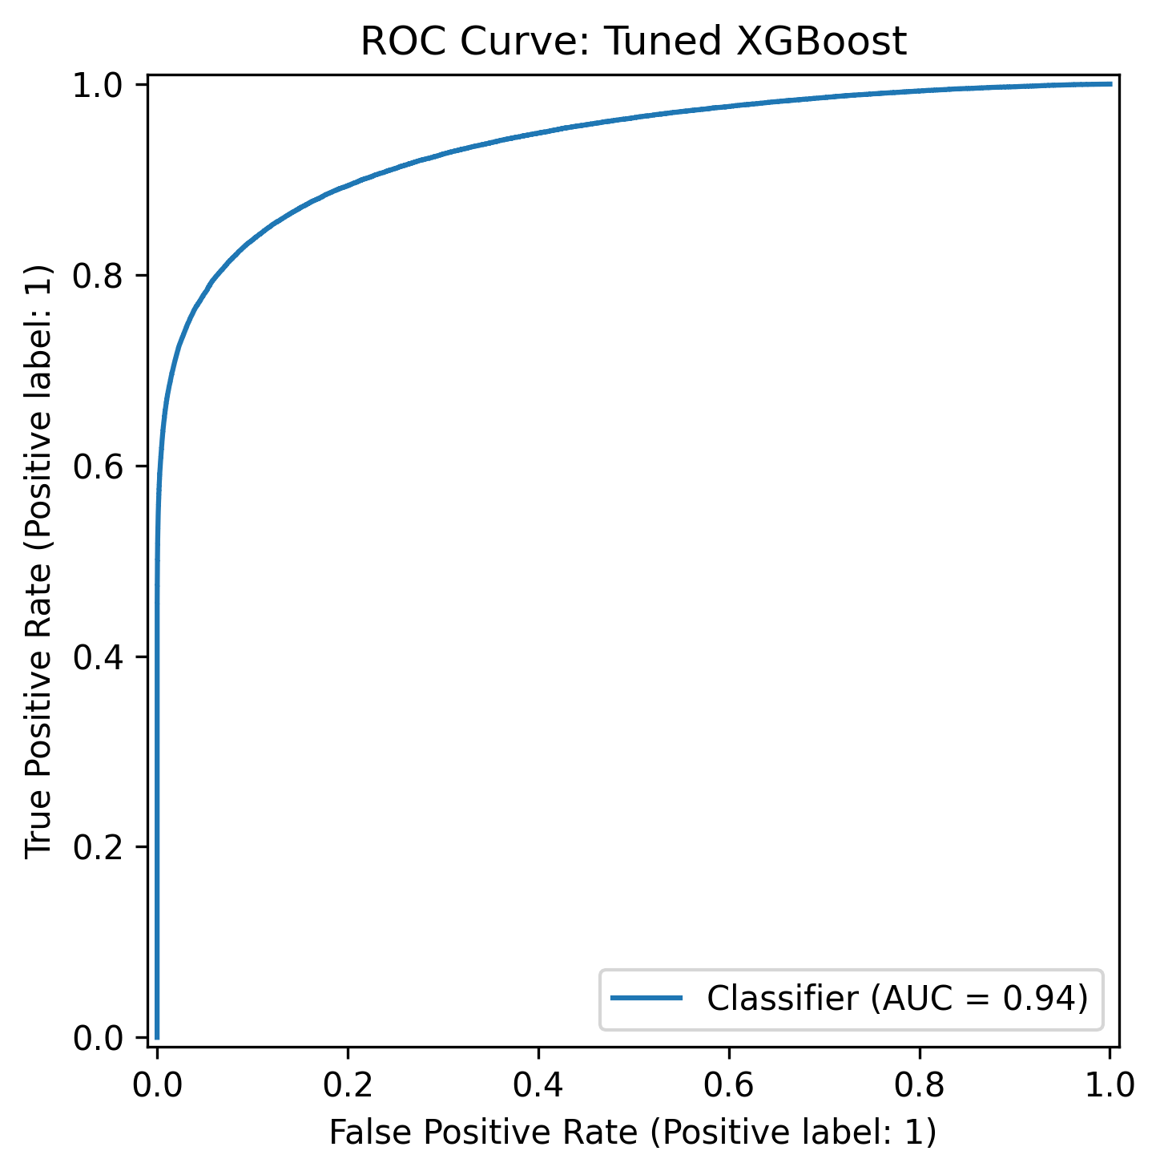
Final Evaluation of Tuned XGBoost
Findings
The model correctly identifies a large number of non-delayed flights while also detecting many delayed flights, though some delayed flights are still misclassified as not delayed.
The ROC curve shows strong discrimination ability, meaning the model can effectively rank flights by their likelihood of delay.
ROC curve confirms that the tuned XGBoost model has strong overall classification performance.

Slide 15
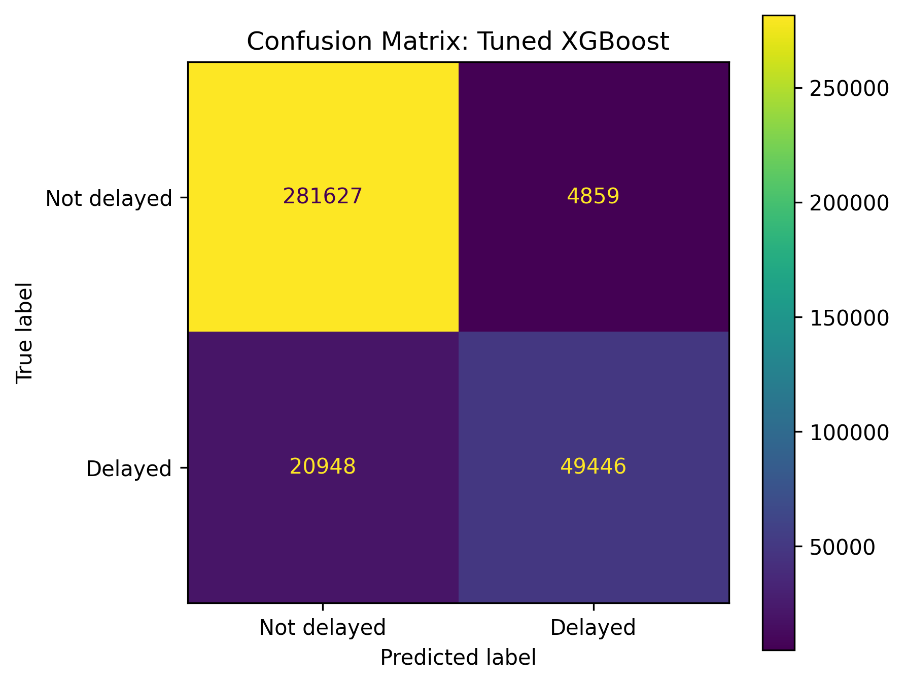
Confusion matrix shows the model’s correct and incorrect classifications for delayed and non-delayed flights.

Slide 16
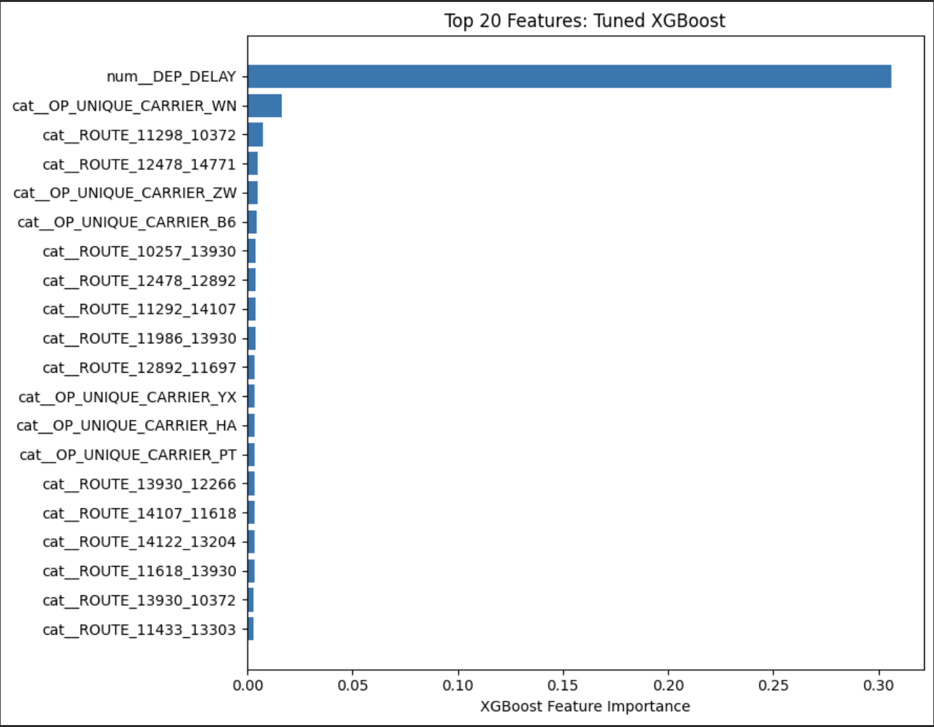
XGBoost: Our Final Model
Outperformed all Models
Reliable and Efficient
One Feature to Rule
Highest accuracy (92.77%), precision (91.05%), and ROC-AUC (0.9373) on the held-out test set
F1 score of 0.793 — best balance of catching delayed flights without too many false alarms
Tuning via 5-fold cross-validation ensured the model learned real patterns, not just memorized the training data
Fast inference (2.07s) — practical for real-world deployment
Excepteur sint occaecat cupidatat non proident, sunt in culpa qui officia deserunt mollit anim id est laborum.

Slide 17
Conclusion
Findings:
Departure delay is the strongest indicator — a flight already running late is very likely to arrive late
Time of day matters: evening flights carry significantly higher delay risk
Real-World Impact:
Airlines could use this model to proactively rebook passengers on high-risk flights

Slide 18
Limitations
Limitation 1
No weather data included — a major real-world driver of delays
Limitation 2
Model trained only on Q1 2025 — may not capture summer/holiday patterns
Limitation 3
19.7% delay class imbalance means missed delays (false negatives) remain a challenge
Limitation 4
Relies heavily on departure delay — limiting its usefulness for pre-departure prediction

Slide 19
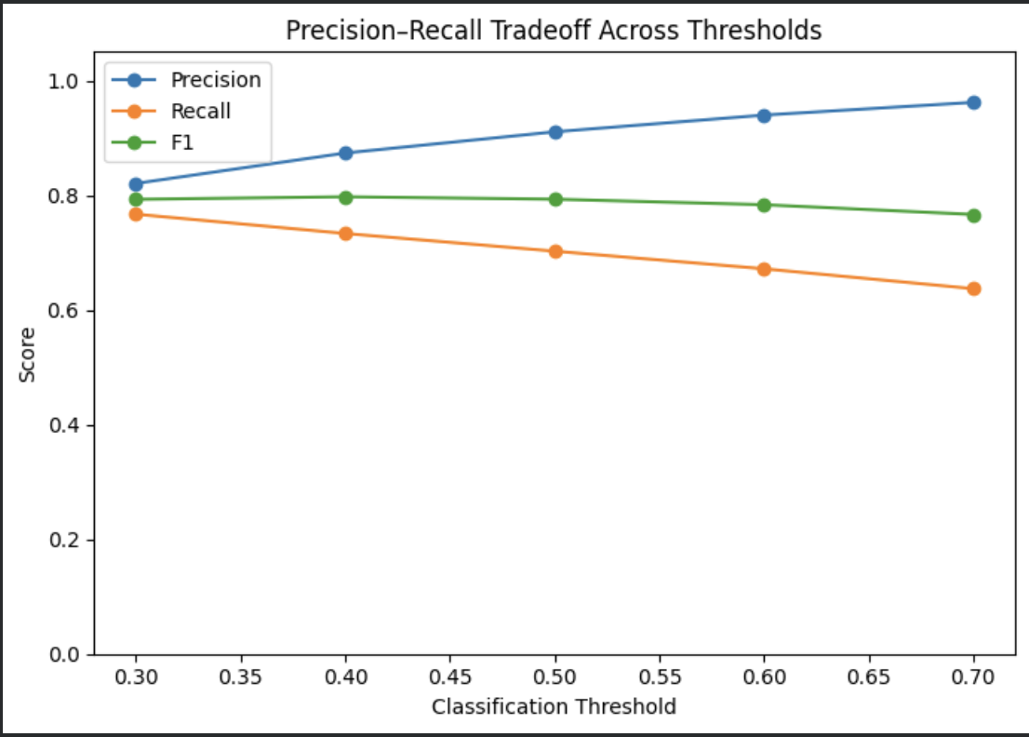
Future Work
Incorporate weather API data (NOAA) and holiday calendars as features
Extend to full-year data to capture seasonal effects
Let airlines tune that threshold based on what's more costly to them

